Slide 1
BURBERRY
Hannah Saunders

Slide 2
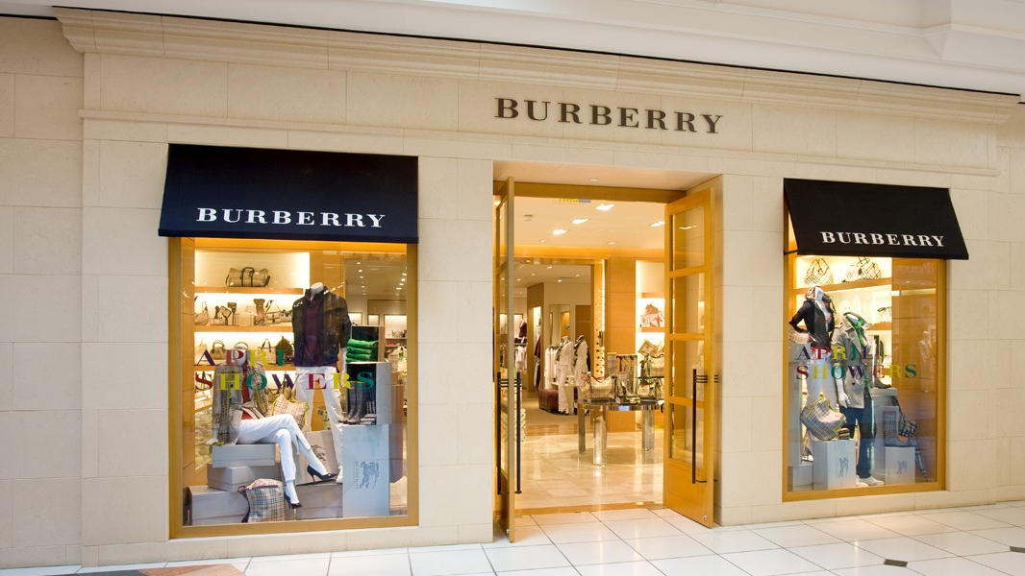
Brand ANALYSIS

Slide 3
About BURBERRY
The Burberry brand has been around since 1856, created by Thomas Burberry. It began because he wanted to design clothing to protect people from the harsh British weather, which led to the invention of gabardine and revolutionizing rainwear. The brand started out as purely practical apparel for those doing exerting work outdoors, like explorers, military, and aviators. In 1990, Burberry moves from a coat company to an outfitter of all apparel and begins appearing at the European fashion weeks. From then on, it was known for its high-end luxury styles and iconic Burberry plaid.

Slide 4
Target customer profile
Age Range | 29-40
Profession | Working corporate job, wealthy spouse
Disposable Income | high
Lifestyle | Work, taking care of home, events with friends
Active Interest/Social Life | Dinner parties, special events, shopping
General Attire | Upscale, professional, glam
Relationship Status | Married or actively dating
Dependents | 0-2
Holidays per Year | Typical American holidays (Christmas, Thanksgiving, NYE), special events for work
Food Shopping | Eats at nice restaurants, shops at Whole Foods or Trader Joe’s
Other Brands | DKNY, Calvin Klein
Aspirational Brands | Chanel, Givenchy

Slide 5
THEME: The winter list
This theme is inspired by winter and the holiday season. The color scheme is neutrals as well as bright orange and maroon. These colors are featured in Burberry’s latest women’s line and bring warmth to the cold season. They are featured in the display both in the clothes and in the background to look somewhat like gift wrap and go with the holiday theme without being too Christmas-like.

Slide 6
THEME BOARD
Notes:
Here, we have the classic Burberry plaid (which is also incorporated into the displays and wall planograms) as well as images from the recent season and a city street in the winter to tie it all together.

Slide 8
Notes:
Since the brand is known for its classic, clean designs, I wanted the theme to be simple and subtle too. The red and silver stripes would be painted with metallic paint to give it that shiny, ribbon-like appearance and the three light fixtures highlight each of the mannequins. The clothing is all from Burberry’s winter line, which incorporates a lot of orange, tan shades, and white. Middle mannequin placed slightly in front of left and right mannequins.

Slide 9
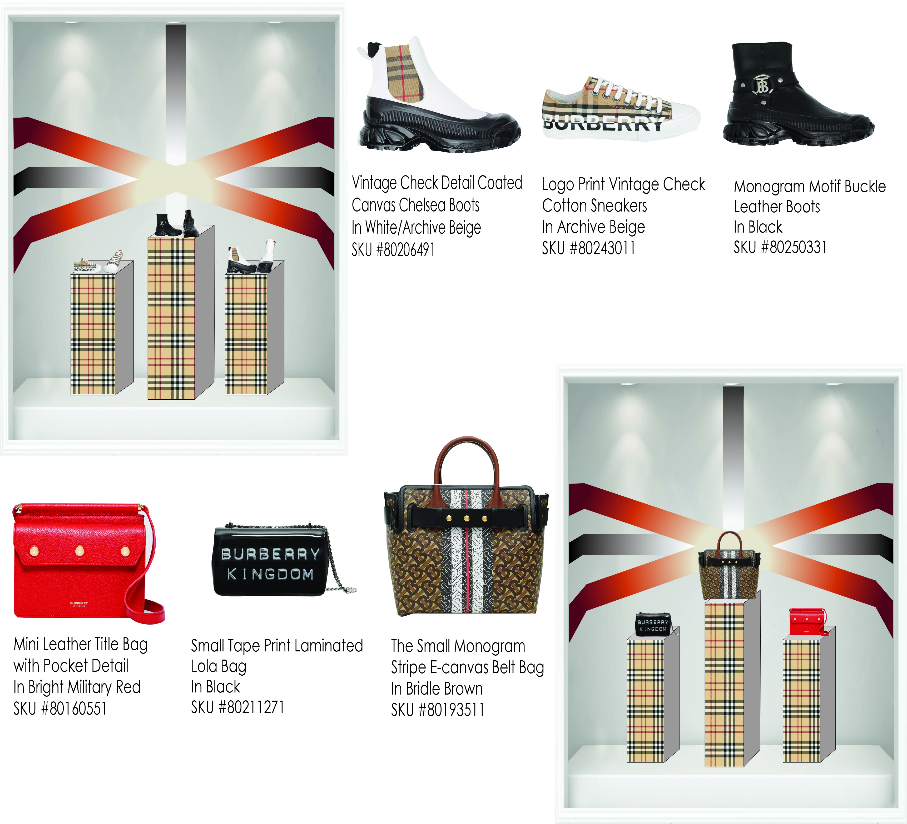
Notes:
Middle stand should be slightly in front of right and left stand. The plaid will be fabric (felt or tweed, something textured) on the stands. Top and sides of stands are mirrors.

Slide 10
PLANOGRAMS

Slide 11
Notes:
Again, classic and simple style. The rectangular molding in the walls should be about 6 inches deep with lighting in each corner pointing towards clothes (lights should not be very noticeable though). Wood shelves, spaced out enough so it doesn’t look crowded. Shoes and accessories in this planogram would be on a nearby table. Keep space clean and no more than 4 of each item hanging at a time. 12’x20’

Slide 13
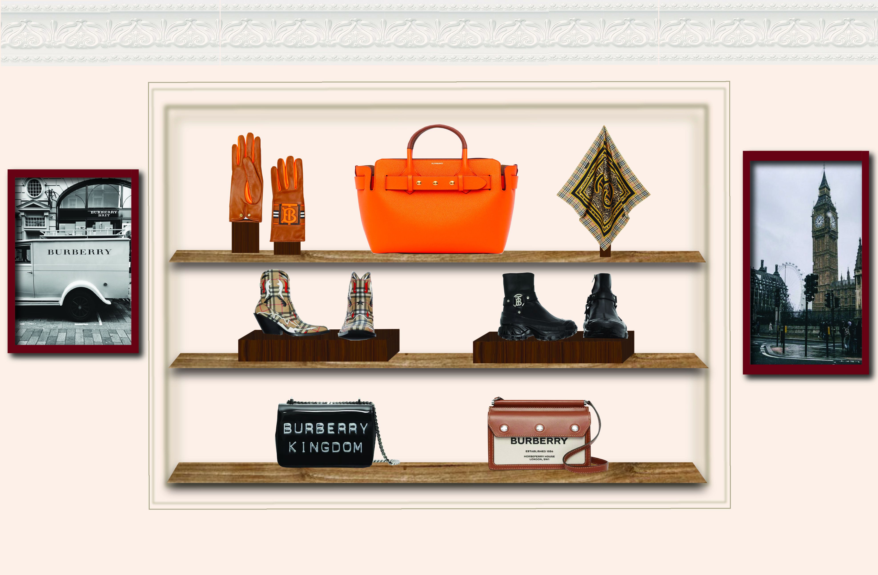
Notes:
This wall features this seasons accessories from the Winter collection. The classic plaid is incorporated in the boots and the orange in the purse and gloves. The molding on this wall will go back about 12” and use a lighter wood for the shelves and a darker wood for the stands with the shoes, gloves, and scarf. The artwork gives this more symmetry as well as dragging the eye towards this display and adding detail. On both walls, crown molding is featured towards the ceiling to add to the sophisticated appearance.

